Slide 1

Web Development Week 1 - HTML

Slide 2
Let’s Introduce Ourself
Where are you from?
What do you do?
Why did you join Bootcamp?
Your future plan?

Slide 3
HTML BASICS

Slide 4
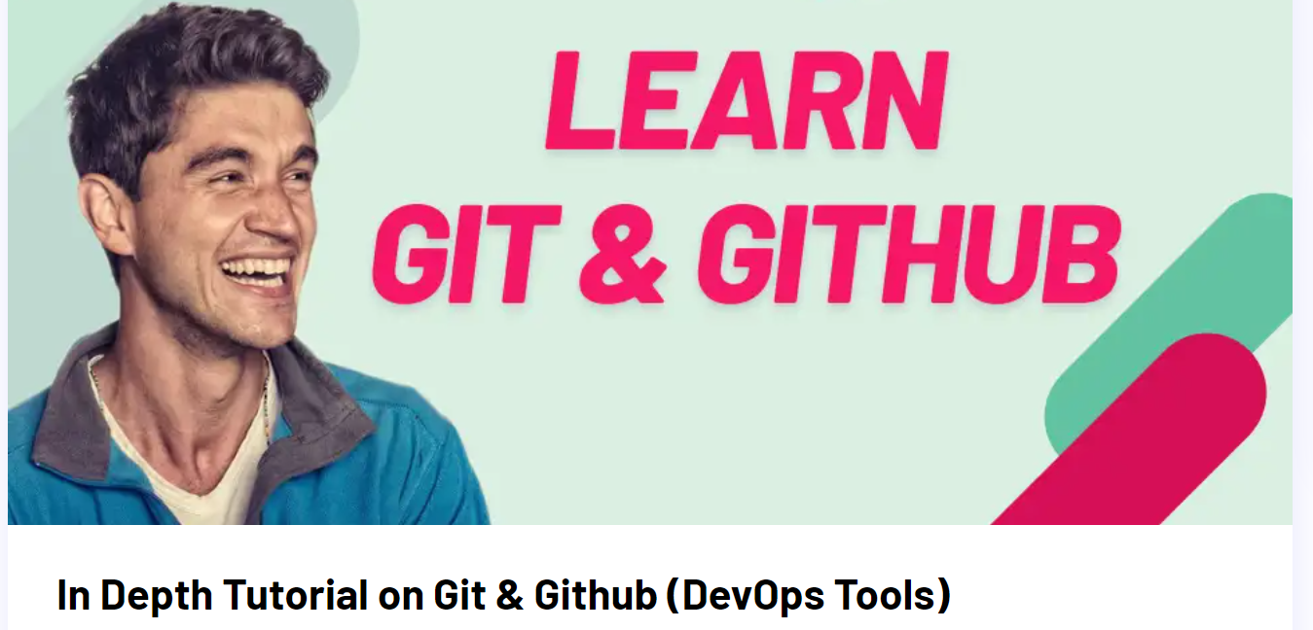
Kick-off Checklist
Please make sure you have successfully completed the following setup steps:
Created an account on Codesandbox https://codesandbox.io/
Installed Google Chrome https://www.google.com/intl/en_uk/chrome/
Installed VS Studio Code
https://code.visualstudio.com/
✓
✓
✓
✓
Sign up on GitHub and also download the Github Desktop version
https://www.youtube.com/watch?v=JN63v_czZqI

Slide 5
Morning Session 1: HTML
We’ll be covering the basics of HTML:
How are websites made?
What is HTML?
Anatomy of an HTML document
Common elements
Complex elements
Types of file paths

Slide 6
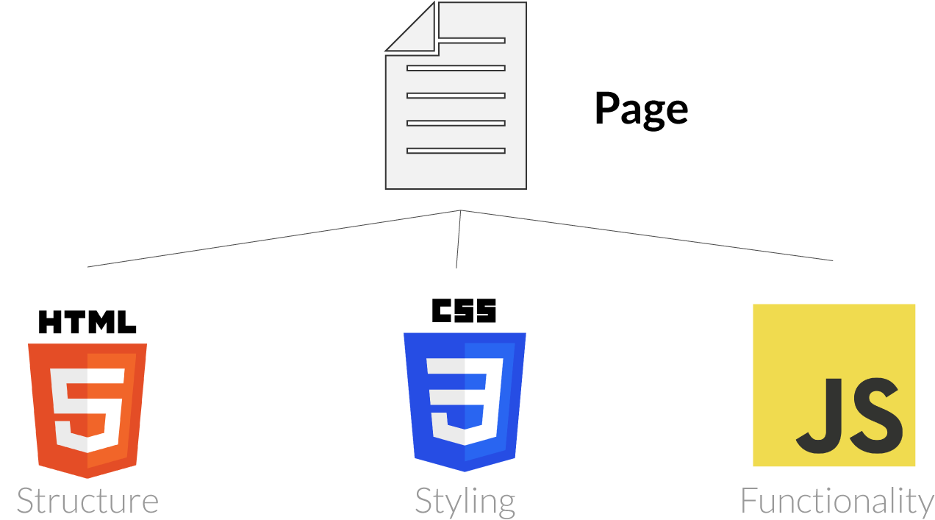
How are websites made?
Websites are built using three different components:
HTML
CSS
JavaScript
Person
Skeleton Appearance Behaviour, actions

Slide 7
How are websites made?
Websites are built using three different components:
HTML
CSS
JavaScript
Person
Skeleton Appearance Behaviour, actions

Slide 8
What is/isn’t HTML?
What IS HTML
Hyper Text Markup Language
Provides the skeleton for all web pages and is the very first thing loaded by the browser
Written using elements which can provide meaning to the pages’ content
Search-engines and screen readers rely on HTML to understand the pages content and it’s meaning
What ISN’T HTML
A design/styling language
A programming language

Slide 9
Anatomy of an HTML document
<!DOCTYPE html>
Must be placed at the beginning of every HTML document.
It informs the browser about type and version of HTML used.

Slide 10
Anatomy of an HTML document
<!DOCTYPE html>
<html>
</html>
This tag tells the browser that this is a HTML document.
It is also the container for all our other HTML elements.

Slide 11
Anatomy of an HTML document
<!DOCTYPE html>
<html lang=”en”>
</html>
We can give the html element an attribute and specify the language of the webpage. This will help search engines and browsers return specific webpage results for different languages.

Slide 12
Anatomy of an HTML document
<!DOCTYPE html>
<html lang=”en”>
<head>
</head>
</html>
The head tag is used to contain metadata about our website.
This can include the title, links to stylesheets and more.
Anything between the starting and closing tags won’t be displayed on the webpage but will be used by the browser.

Slide 13
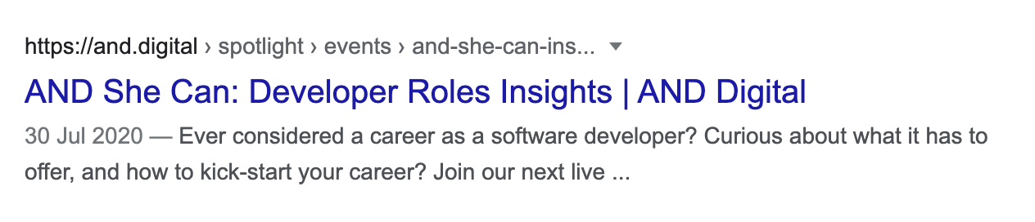
Anatomy of an HTML document
<!DOCTYPE html>
<html lang=”en”>
<head>
<title>Page Title</title>
</head>
</html>
The title tag is a required tag and describes the title of the webpage. This will be used by search engines when displaying the webpage results.

Slide 14
Anatomy of an HTML document
<!DOCTYPE html>
<html lang=”en”>
<head>
<title>Page Title</title>
</head>
<body>
</body>
</html>
This tag defines the document’s body, which has the main content of the page. HTML elements we want to be displayed on the web page must be contained within these tags.

Slide 15
Anatomy of an element
The building blocks of HTML are called ELEMENTS
Element
Opening tag
Closing tag
>
<p
lang=”en-US”
Content
</p>
Attribute
name
Attribute
value
Element
name
Attribute

Slide 16
Anatomy of an element
Some elements don’t need any attributes
In between opening/closing tags there could be text or another element (children)
Some elements only function with mandatory attributes
<p>Content</p>
<div>
<p>content</p>
</div>
Enclosed closing tag doesn’t allow for children
<img src=”./imgs/dog.png” />

Slide 17


Exercises - Website folder structure
Template link:https://codesandbox.io/s/cc-web-development-np058r?file=/index.html
Throughout the 12 week course, you will be developing your own portfolio website. To get you started we have created a template with a basic website folder structure. Please copy this by “forking” the codesandbox.
Template
css
images
main.css
placeholder-and.png
index.html
contact.html
top-five.html
placeholder-profile.jpg

Slide 18
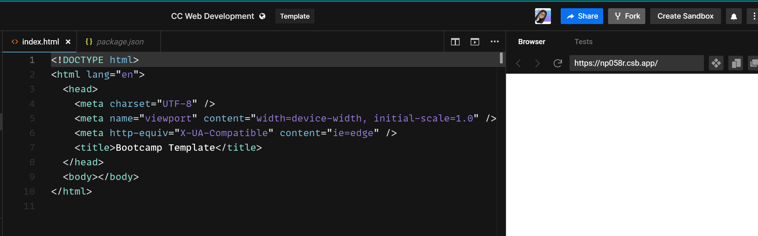
How to fork a repo

Slide 19
Common elements
Header elements used for titles (h1 for most important to h6 for least important)
<h1>The most important header. This should only be used once per page</h1>
<h2>The second most important header</h2>
Division of content
<div> …. </div>
Paragraph of text
<p>This is a paragraph</p>
Basic horizontal line
<hr>
Line break or force a new line
<br>

Slide 20
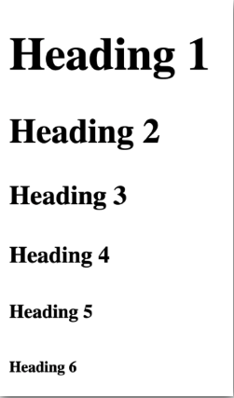
Headings
<h1>Heading 1</h1>
<h2>Heading 2</h2>
<h3>Heading 3</h3>
<h4>Heading 4</h4>
<h5>Heading 5</h5>
<h6>Heading 6</h6>

Slide 21
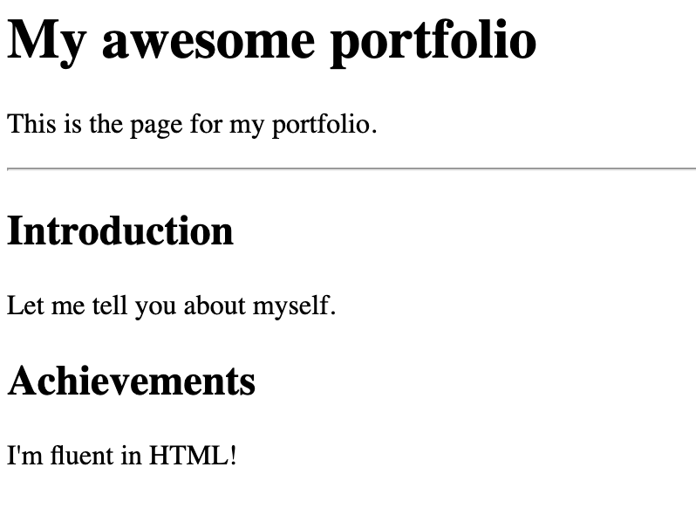
Common elements
https://codesandbox.io/s/festive-roentgen-6czib4?file=/index.html
Code with us:

Slide 22
Common elements
<h1>My awesome portfolio</h1>
<p>This is the page for my portfolio.</p>
<hr>
<div>
<h2>Introduction</h2>
<p>Let me tell you about myself.</p>
</div>
<div>
<h2>Achievements</h2>
<p>I’m fluent in HTML!</p>
</div>

Slide 23
Exercises
Exercise 1
In your portfolio codesandbox : Change the h1 element to your name, add your current occupation as an h2 element, and write an introductory paragraph about yourself using the p element.

Slide 24
Complex elements
<ul>
<li>...</li>
<li>...</li>
</ul>
Unordered Lists. Each list item starts with an li tag and will have a bullet point by default.
Ordered Lists. Each list item starts with an li tag and will be marked with a number by default.
<ol>
<li>...</li>
<li>...</li>
</ol>

Slide 25
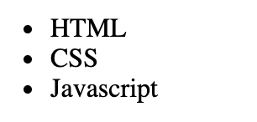
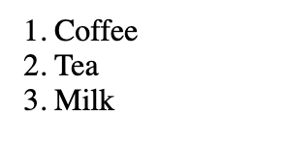
Complex elements
https://codesandbox.io/s/code-with-us-2t00fd
<ul>
<li>HTML</li>
<li>CSS</li>
<li>Javascript</li>
</ul>
<ol>
<li>Coffee</li>
<li>Tea</li>
<li>Milk</li>
</ol>
Code with us:
Finished code: https://codesandbox.io/s/eager-mcclintock-0sh4yp

Slide 26
Commenting Code
You can add notes that html will ignore.
<!-- this is where comments go -->

Slide 27
Exercises
Exercise 2
In your portfolio CodeSandbox : Add an unordered list to your page above your h1. Your list items will be the other pages of your portfolio eg.: Home, Contact, Interests

Slide 28
Complex elements
The image element only has attributes (no content) and has an enclosed closing tag. The src attribute specifies the path to the image. The alt attribute provides an alternative text for the image, in case the user cannot view it for some reason.
<img src=”filename.filetype” alt=”” />
<img src=”dogPicture.png” alt=”A happy dog” />
The anchor element is used to create a hyperlink that you can click and jump to another document or webpage. The href attribute specifies the destination address of the link.
<a href=”https://www.facebook.com”>Click me to go to Facebook</a>

Slide 29



Complex elements
<a href=”https://www.google.com”>Click me</a>
<img src=”https://image.shutterstock.com/image-photo/give-me-five-puppy-pressing.png” alt=”high-five-dog” />
https://codesandbox.io/s/complex-elements-y9nv0q?file=/index.html:0-979

Slide 30
Exercises
Exercise 3
Using anchor elements (<a>), add links to the Unordered List you created in exercise 2. These links should go directly to the pages already supplied in the template (e.g contact.html).
Using an image element, add a photo of yourself underneath your introductory paragraph.

Slide 31
Exercises
Code with us!
Let’s explore the Google Chrome developer tools!
Navigate to the BBC’s homepage
Open the developer tools* *Right click on a headline on the page, and click inspect from the dropdown
You should see the headline inside a HTML tag. Change the title of this headline to be your name.
To undo any changes refresh the page
Try and change the headline and summary of a news article to tell the world you’ve started your journey into web development!

Slide 32
Session 1 Recap
Throughout this session you learnt about:
How are websites made?
What is HTML?
Anatomy of an HTML document
Common elements
Complex elements
Types of file paths

Slide 33
Additional Information (Optional)

Slide 34
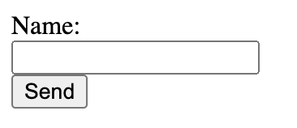
Forms
Forms are essential for many websites, and are really easy to make! Each field is known as an input and usually has a label to describe the input.
To link the label with its input field, we use the for property on the label and we set it to the name we have given to our input.
<form id=”myAwesomeForm”>
<label for=”name”>Name:</label><br>
<input name=”name” type=”text”/><br>
<input type=”submit” value=”Send”/>
</form>

Slide 35
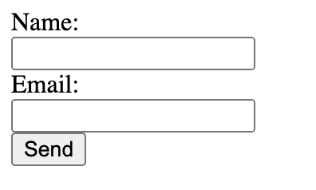
Forms
For forms to actually function, you will also need some JavaScript. We provided this in the codesandbox above.
<form id=”myAwesomeForm”>
<label for=”name”>Name:</label><br>
<input name=”name” type=”text”/><br>
<label for=”email”>Email:</label><br>
<input name=”email” type=”email”/><br>
<input type=”submit” value=”Send”/>
</form>

Slide 36
References
https://www.freecodecamp.org/news/html-cheat-sheet-html-elements-list-reference/
https://www.freecodecamp.org/news/html-best-practices/
https://www.freecodecamp.org/news/html-tables-table-tutorial-with-css-example-code/
www.w3schools.com

